Slide 1
ICS & SCADA Cyber Defense
How Ready Is YOUR Organization?

Slide 2
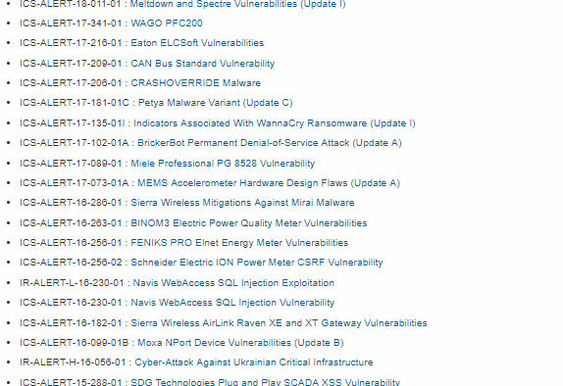
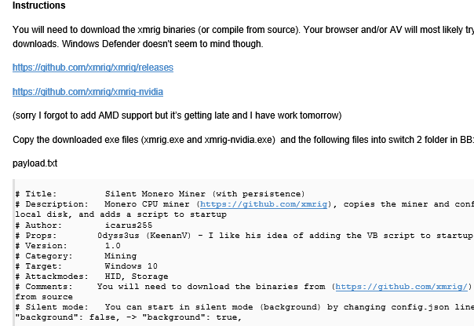
How Real is this for us?
Current best record for powning a windows 2016 Datacenter Server: 17 seconds (unofficially 15 seconds)

Slide 3
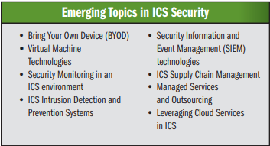
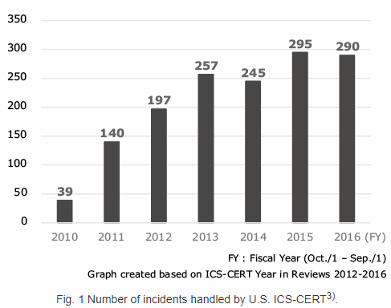
All CI Sectors are being targeted
Rye Brook, New York Dam Attack
SWIFT Global Bank Messaging System (Multiple Times This Year Alone)
U.S. Nuclear Power Plants – Impacted Facilities And Number Of Attacks Not Being Reported
“Election System Hacking”

Slide 4
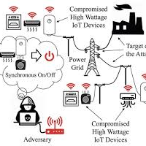
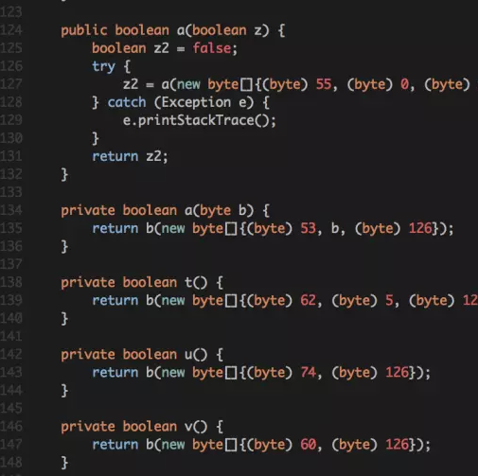
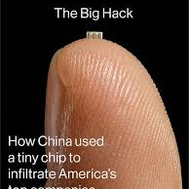
Threats & threat vectors
Every mode of communications has a known vulnerability
Bluetooth - 8.2 billion devices worldwide. Many devices are affected, including laptops, smart cars, smartphones and wearable gadgets.
Cellular – a Recipe book for hacking 4G LTE connection recently sold for $7.00 USD per copy on the dark web. 20k copies were downloaded.
Wi-Fi – not much more to say about this one….
Ethernet, DSL, POTS, RF – all have known vulnerabilities

Slide 5
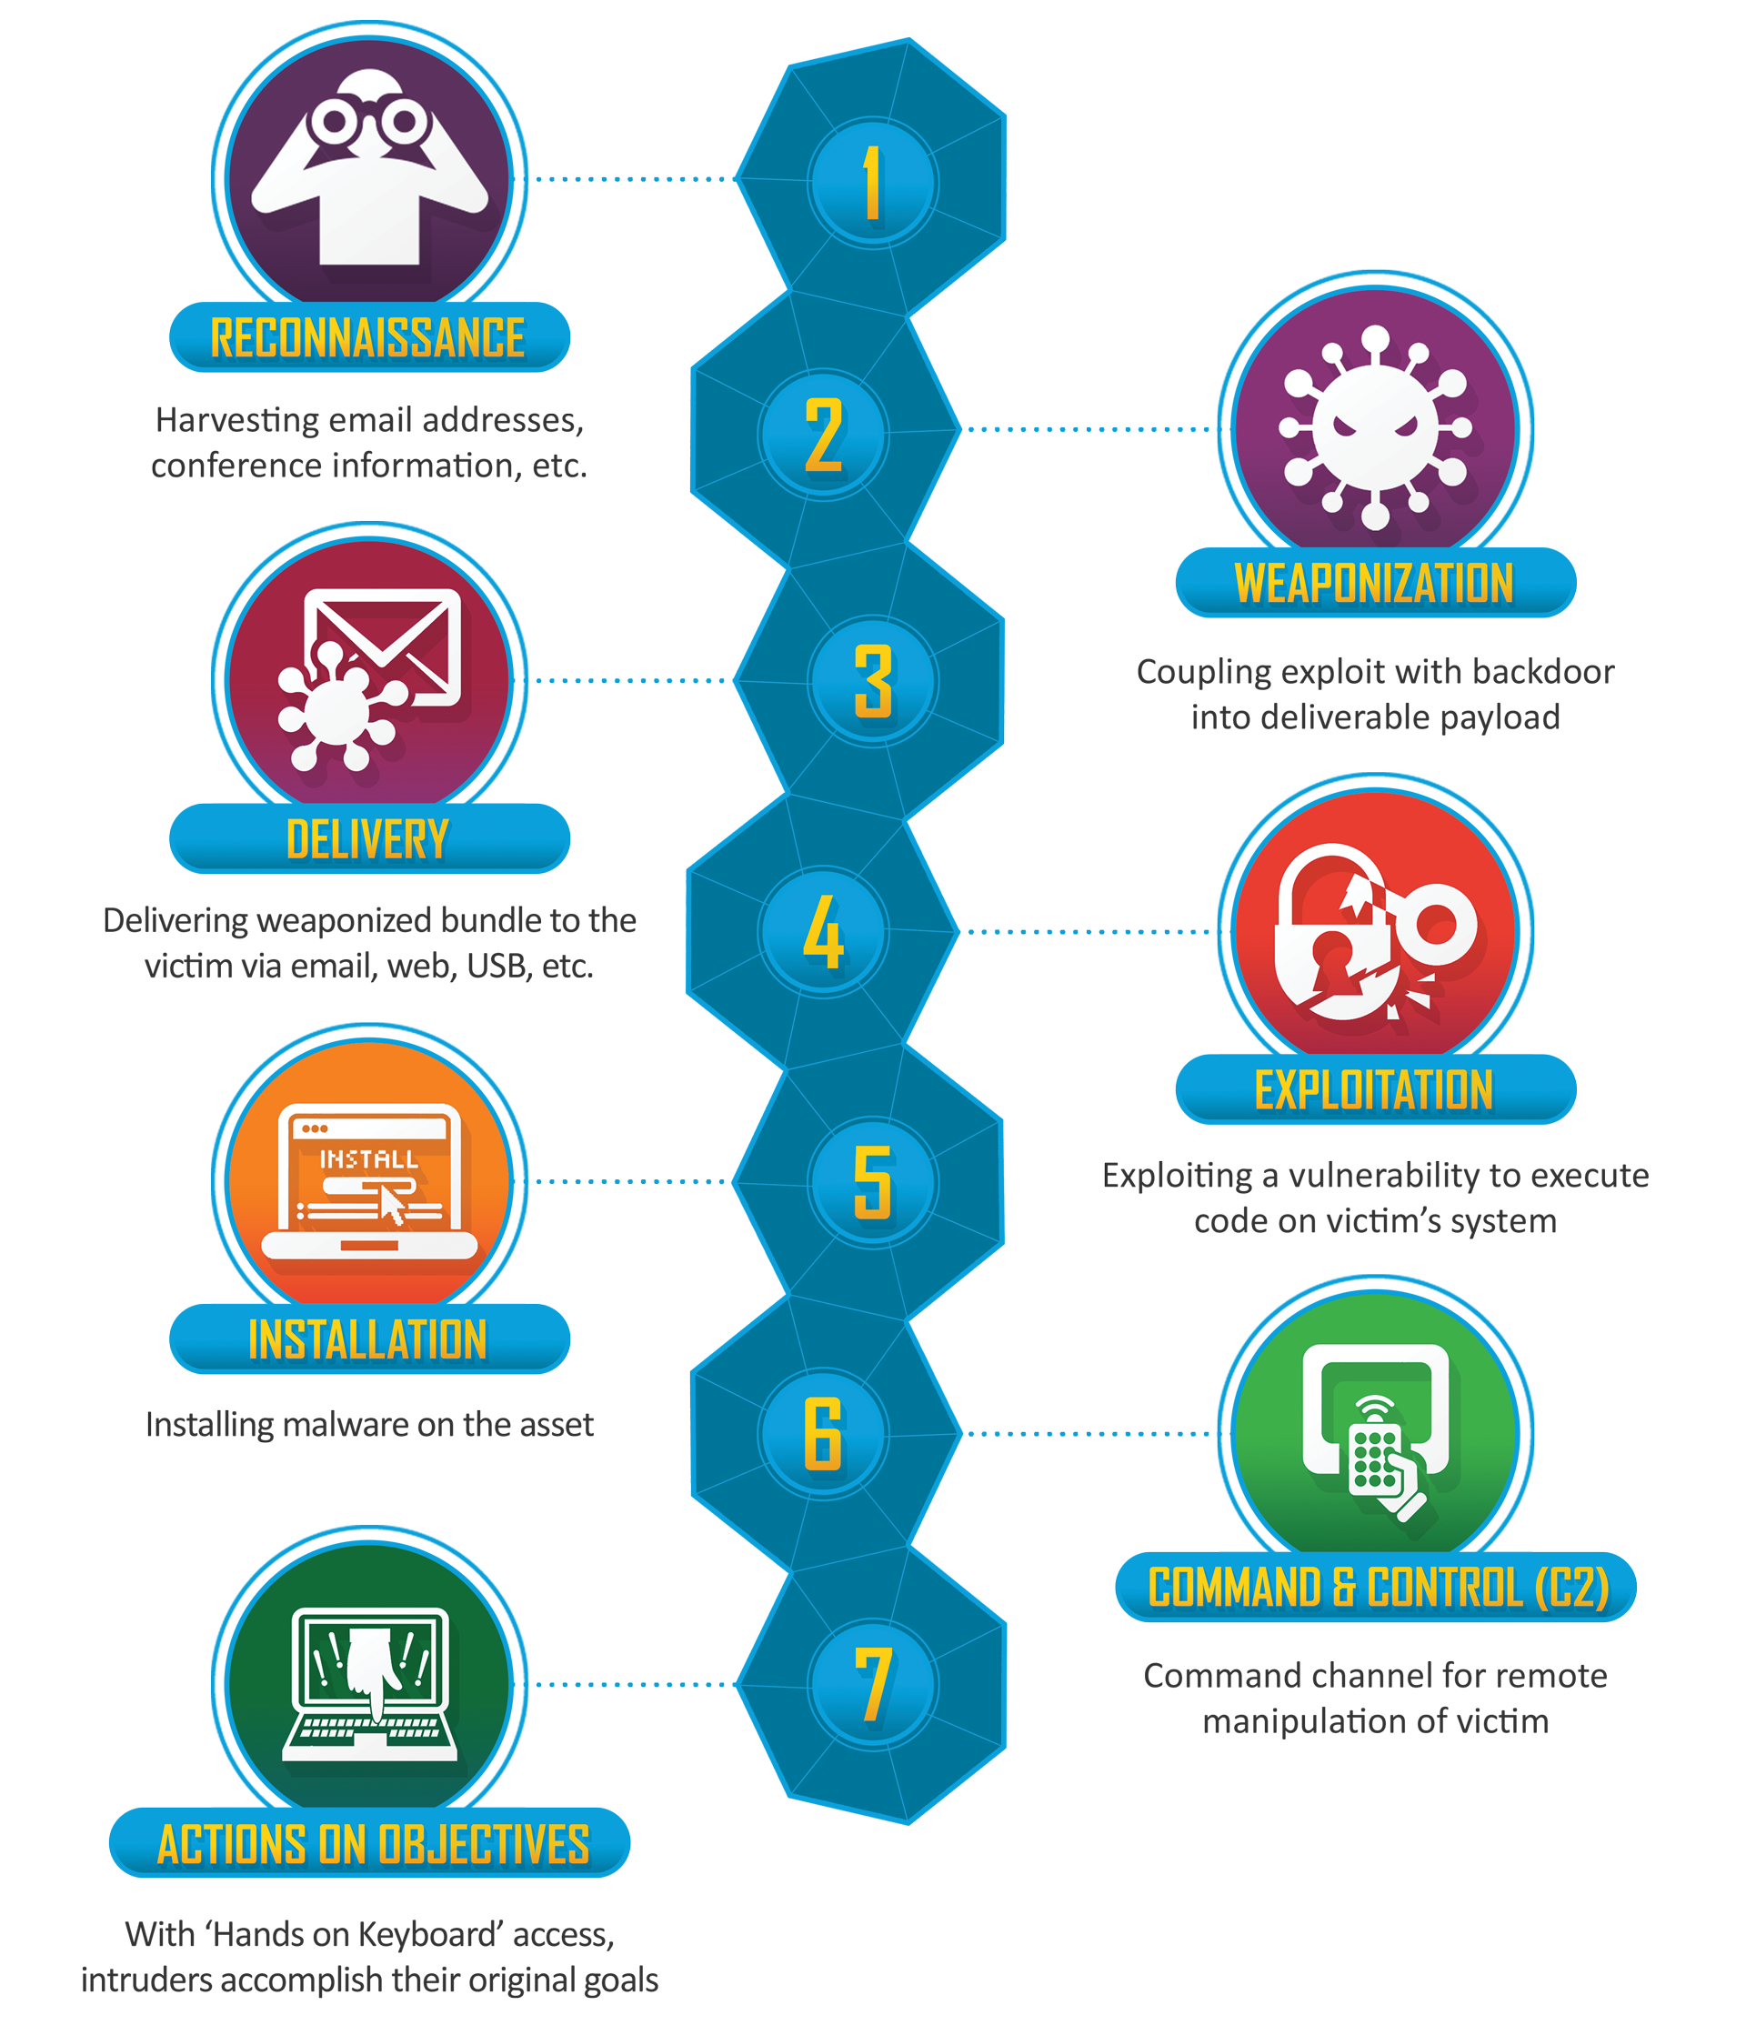
Defense in depth
The Lockheed Martin CYBER KILL CHAIN®
approaches for securing ICS & SCADA Systems
Education and training
Network Segmentation
Inventory management
Processes and controls
Multi-factor authorization and access control
Automated systems monitoring
Threat hunting culture
Executive support – capex and opex line items do not count

Slide 6
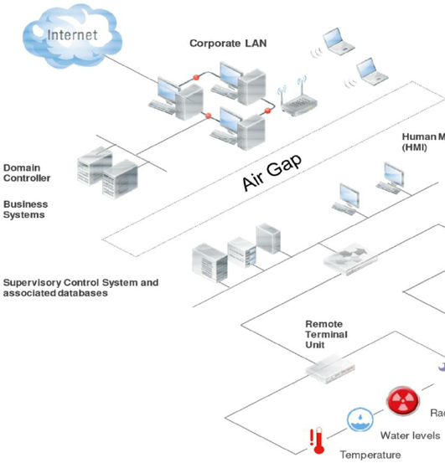
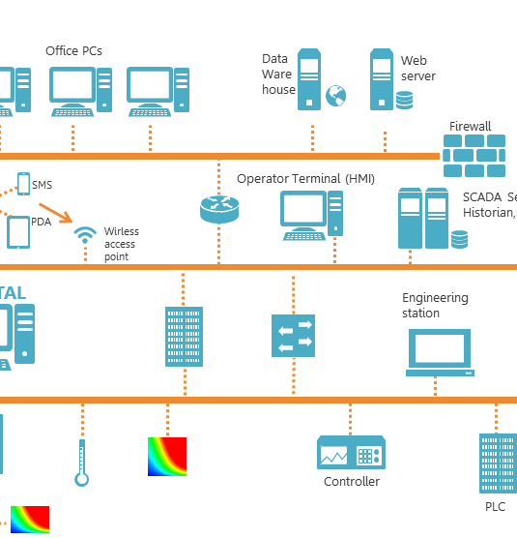
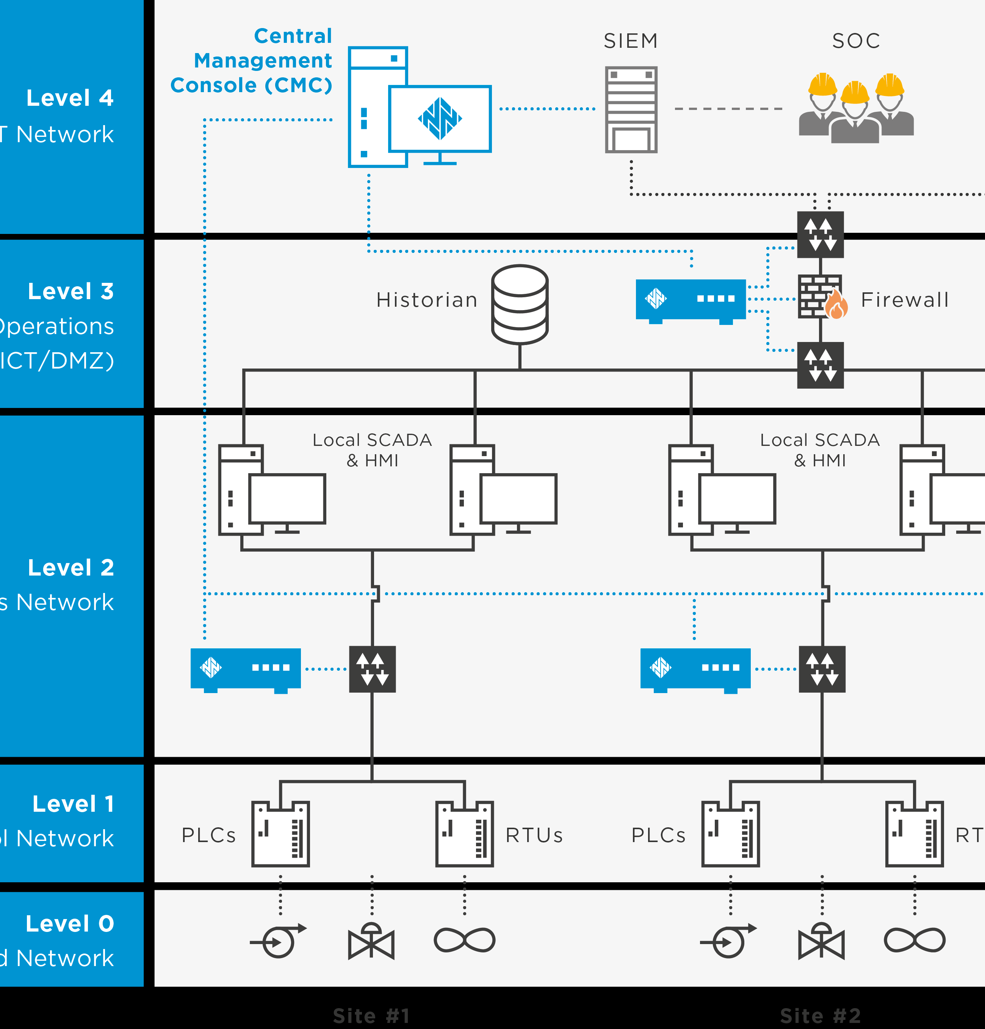
Network Topologies
Resources and organizations:
InfraGard – www.infragard-la.org & www.infragard.org
DHS / National Cybersecurity and Communications Integration Center (NCCIC) -- https://www.dhs.gov/national-cybersecurity-and-communications-integration-center
Ics-cert - https://ics-cert.us-cert.gov/Information-Products
NIST – https://www.nist.gov/cyberframework
Governing SCADA Security organizations including: Electric: North American Electric Reliability Corporation Critical Infrastructure Protection (NERC CIP), Chemicals: Chemical Industry Data Exchange/American Chemistry Council (CIDX/ACC), Natural gas: American Gas Association 12 (AGA 12), Oil and liquids: American Petroleum Institute (API), Manufacturing: International Society for Automation/International Electrotechnical Commission (ISA/IEC 62443) (formerly ISA 99)

Slide 7
Defense is our responsibility
Leverage all resources, constantly learn, be curious, schedule threat hunts, do not go it alone

Slide 8
Roadmap To Preparedness & Resiliency
Understand As-Is State
Prioritize Risk Threats/Level of Concern
Estimate current capabilities
Create Tabletop exercises to validate As-Is
Update understanding of As-Is – be real!
Create plan to achieve desired capability state
Socialize & Brainstorm Risk/Threat scenarios
Understand As-Is State

Slide 9
Planning For A Secure Culture
Do we know what would be most effective to train our people on?
What are the top three to five behaviors that are impacting our company?
Building a Secure Culture
Predict
Prevent
Detect
Respond
How well does our corporate culture prepare us to prevent attacks (that is, insider threats)?
What types of attacks can be prevented through training and awareness?
Are we conducting training on how to respond to certain events?
Are mini tabletop exercises appropriate for a segment of our people?
Do our employees know how to self-report suspected security issues?
Do they know how to react to suspicious behavior?

Slide 10
Current Capabilities — Assessment
Preparedness for All Hazard Scenarios: (Cyber/Tech Incident, Weather Event, Vendor Disruption, Etc.)
Predict Detect Respond Prevent
Prepare or perish – Build resiliency, define roles, communications & authority in advance.

Slide 11
Capability & Preparedness Overview
Predict
Prevent
Proactive Exposure Assessment
Harden and Isolate Systems
Predict Attacks
Divert Attackers
Baseline Systems
Continuous Monitoring and Analytics
Prevent Incidents
Remediate/ Make Change
Detect Incidents
Design/Model Change
Confirm and Prioritize
Investigate/Forensics
Contain Incidents
Respond
Detect

Slide 12
Questions? Thank You!
Charles George, CISSP, MS-CSP

Slide 13
Background and Experience
~10 Yrs US Navy Intelligence Specialist
~10 Years Fortune 100 CIO/CISO – Global Manufacturing & HiTech Finance
~10 Yrs CI Experience – Water Sector CIO/CISO; Multiple ICS SCADA Implementations
Lead Cyber Response Units For DoD, Civilian & Corporate Data Breaches
Offensive/Defensive Cyber And OpSec / Physical Security SME To JCS, USSTRATCOM, DIA
Cloud Solutions Provider – Azure, AWS, GWS, Hybrid & Private Cloud Solutions
cj.george@firstmaridian.com | https://www.FirstMaridian.com
A Proud Member of

Slide 14
Templates & Tools For Your Business – El-freebos
TEMPLATES, RESOURCES, TOOLS & REFERNCES – THE FREE KIND
Policies, Guidelines, Security Standards & Templates
The SANS Institute, SANS Security Policy Resource page; updated 2017; © 2000-2017 SANS™ Institute <https://www.sans.org/security-resources/policies>
Tools and Resources
KnowBe4 Phish Alert Button, (Free and Paid options) <https://knowbe4.zendesk.com/hc/en-us/articles/208969608-Phish-Alert-Installation-Guide>
Security Awareness & Anti-Phishing Training Options Abound,
InfoSec Institute <https://www.infosecinstitute.com/security-iq>
Kevin Mitnick Security Awareness Training <https://www.knowbe4.com/products/kevin-mitnick-security-awareness-training/>
End User Security Awareness Training Management <https://www.cybrary.it/enterprise-training-solutions/end-user-security-awareness/>
Video Reviews of Anti-Phishing Tools <https://www.brighttalk.com/search?q=training>?
Your humble & friendly local resources <https://www.firstmaridian.com>

Slide 15
Sources & Citations
RESEARCH SOURCES:
Ponemon Institute© Research Report “2016 Cost of Cyber Crime Study & the Risk of Business Innovation” Sponsored by Hewlett Packard Enterprise. Published October, 2016. <http://www.ponemon.org/local/upload/file/2016%20HPE%20CCC%20GLOBAL%20REPORT%20FINAL%203.pdf>
Verizon Insight Labs “2017 Data Breach Investigations Report”10th Edition. Publication month and year: April 27, 2017 http://www.verizonenterprise.com/verizon-insights-lab/dbir/2017/
Verizon Insight Labs “2015 & 2016 Data Breach Investigations Report”8th & 9th Editions respectively. <http://www.verizonenterprise.com/verizon-insights-lab/dbir/#Explore security reports>
National Institute of Standards and Technology (NIST) “Framework for Improving Critical Infrastructure Cybersecurity” Publication Date: January 10, 2017 <https://www.nist.gov/news-events/news/2017/01/nist-releases-update-cybersecurity-framework>
IDG “The State of Application Security in Today’s Application Economy” <http://thepinnaclegroup.com/news/trending-stories#ts-2017-State-of-Application-Security-Findings$map-36928-xappid>

