Slide 1
USCG Regulated Facilities
Common deficiencies
USCG Sector New Orleans
Facility Compliance Branch
MSTC Jason Spence
MST1 Matt Lindsay

Slide 2
Stats and numbers
Sector New Orleans has 223 regulated Facilities
Deficiencies noted for 2019: 54
Deficiencies noted for 2018: 118
Enforcement Actions for 2018-2019: 0

Slide 3
Discussion:
Common Deficiencies Of:
Safety and Pollution Prevention Inspections, (33CFR154)
Security Inspections / MTSA/ (33CFR105)
Government Initiated Unannounced Exercises (GIUE)

Slide 4
Safety & Pollution Prevention Inspections
Records: 33CFR154.740
Hose Markings: 33CFR154.500(e)
Signage: 33CFR154.735(v)
Exercises: 33CFR154.1055 (OPA90 only)
Inspection and Maintenance Records: 33CFR154.1057 (OPA90 only)

Slide 5
Records: 33CFR154.740
Each facility operator shall maintain at the facility and make available for examination by the COTP:
(a) A copy of the letter of intent for the facility;
(b) The name of each person designated as a person in charge of transfer operations at the facility and certification that each person in charge has completed the training requirements;
(c) The date and result of the most recent test or examination of each item tested or examined under §156.170 (example: hose test records)
(d) The hose information ( test pressure, test date, date of manufacture and burst pressure)
(e) The record of all examinations of the facility by the COTP within the last 3 years;
(f) The Declaration of Inspection required (30 days)
(g) A record of all repairs, auto shut downs, and calculations made within the last three years involving any component of VCS. (if applicable)
(j) If they are not marked as such, documentation that the portable radio devices in use at the facility under §154.560 of this part are intrinsically safe.

Slide 6
Hose Markings 33CFR154.500(e)
(e) Each hose must be marked with ONE of the following:
(1) The name of each product for which the hose may be used; or
(2) For oil products, the words “OIL SERVICE”; or
(3) For hazardous materials, the words “HAZMAT SERVICE—SEE LIST” followed immediately by a letter, number or other symbol that corresponds to a list or chart contained in the facility's operations manual or the vessel's transfer procedure documents which identifies the products that may be transferred through a hose bearing that symbol.
(f) Each hose also must be marked with the following, except that the information required by paragraphs (f)(2) and (3) of this section need not be marked on the hose if it is recorded in the hose records of the vessel or facility, and the hose is marked to identify it with that information:
(1) Maximum allowable working pressure;
(2) Date of manufacture; and
(3) Date of the latest test.
(g) The hose burst pressure and the pressure test used for the test MUST NOT be marked on the hose and must be recorded elsewhere.

Slide 7
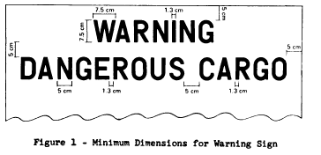
Warning Signs 33CFR154.500(v)
v) Warning signs shall be displayed on the facility at each SHORESIDE entry to the dock or berth, without obstruction, at all times for fixed facilities and for mobile facilities during coupling, transfer operation, and uncoupling. The warning signs shall conform to 46 CFR 151.45-2(e)(1) or 46 CFR 153.955

Slide 8
46 CFR 153.955
(b) each warning sign must have the following legends:
(1) Warning.
(2) Dangerous Cargo.
(3) No Visitors.
(4) No Smoking.
(5) No Open Lights.
(c) Each letter must be block style, black on a white background.
(d) Each letter must:
(1) Be 7.5 cm (approx. 3 in.) high;
(2) Be 5 cm (approx. 2 in.) wide except for “I”, “M”, and “W”

Slide 9
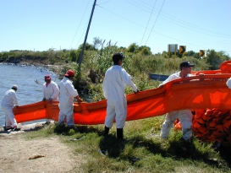
Exercises: 33CFR154.1055
The following are the minimum exercise requirements for facilities covered by this subpart:
(1) Qualified individual notification exercises (quarterly).
(2) Spill management team tabletop exercises (annually). In a 3-year period, one of these exercises must include a worst case discharge scenario.
(3) Equipment deployment exercises:
(i) Semiannually for facility owned and operated equipment.
(ii) Annually for oil spill removal organization equipment.

Slide 10
Inspections and Maintenance 33CFR154.1057
a) A facility owner or operator required to submit a response plan under this part must ensure that—
(1) Containment booms, skimmers, vessels, and other major equipment listed in the plan are inspected and maintained in accordance with manufacturer's recommendations, and best commercial practices; and
(2) All inspection and maintenance records are maintained for 3 years.
(c) This section does not apply to major equipment available from an oil spill removal organization through the written consent.

Slide 11
Security Inspections / MTSA/ (33CFR105)
Facility Recordkeeping Requirements: 33CFR105.225
Signs for Access Control: 33CFR105.255(f)(3)
Signs for Restricted Area: 33CFR105.260(b)

Slide 12
Facility Recordkeeping Requirements: 33CFR105.225
(1) Security Training: the date of each session, duration of session, a description of the training, and a list of attendees;
(2) Drills and exercises. For each drill or exercise, the date held, description of drill or exercise, list of participants, and any best practices or lessons learned which may improve the (FSP);
(3) Incidents and breaches of security. For each incident or breach of security, the date and time of occurrence, location within the facility, description of incident and description of the response;
(4) Changes in MARSEC Levels. For each change in MARSEC Level, the date and time of notification received, and time of compliance with additional requirements;
(5) Maintenance, calibration, and testing of security equipment. For each occurrence of maintenance, calibration, and testing, record the date and time, and the specific security equipment involved;
(6) Security threats. For each security threat, the date and time of occurrence, how the threat was communicated, who received or identified the threat, description of threat, to whom it was reported, and description of the response;
(7) Declaration of Security (DoS) A copy of each single-visit DoS and a copy of each continuing DoS for at least 90 days after the end of its effective period;
(8) Annual audit of the FSP. For each annual audit, a letter certified by the FSO stating the date the audit was completed;

Slide 13
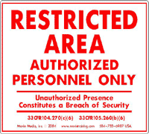
Signs for Restricted Area : 33CFR105.260(b)
Ensure that all restricted areas are clearly marked and indicate that access to the area is restricted and that unauthorized presence within the area constitutes a breach of security

Slide 14
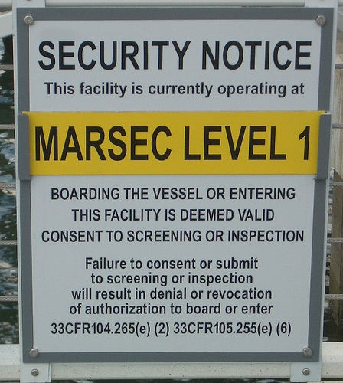
Signs for Access Control: 33CFR105.255(d)(3)
Conspicuously post signs that describe security measures currently in effect and clearly state that:
(i) Entering the facility is deemed valid consent to screening or inspection; and
(ii) Failure to consent or submit to screening or inspection will result in denial or revocation of authorization to enter.

Slide 15
Government Initiated Unannounced Exercise
(OPA 90 Applicable only)
Notifications
Boom Deployed within 1 hour
Recovery deployed with 2 hours

Slide 16
Facility Compliance Branch
Points of Contact:
Facility Compliance Branch: FacilitiesNOLA@uscg.mil
504-365-2370
MSTC Jason Spence: Jason.M.Spence@uscg.mil
504-365-2381
MST1 Matt Lindsay: Matthew.T.Lindsay@uscg.mil
504-365-2286

Slide 17
Questions?

