Slide 1



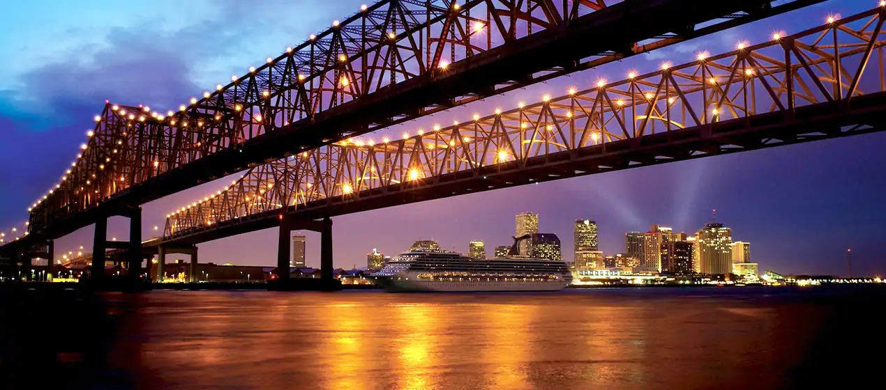
2019 FBI / INFRAGARD SOUTHCENTRAL REGIONAL
INFORMATION SHARING INITIATIVE
May 14,2019 / Time: 8:00 AM – 4:00 PM
AGENDA
8:00 AM Pledge of Allegiance / Welcome Remarks (Lester Millet III / SA Corey Harris)
8:10 AM Opening Remarks (SAC Eric J. Rommal / FBI N.O., Paul Aucoin / Port of South Louisiana,
Capt. Kristi Luttrell USCG Sector N.O. COTP, Gregory M. Kennedy, USDOJ Eastern Dist. Of La.
9:00 AM FBI OPS Intel Coordinator Working Group / Johnny Starrunner, Unit Chief
9:30 AM ODNI Overview of Intel Community / Elena Kim Mitchel
10:00 AM Break
10:00 AM FBI NCTC / Global Terrorism Overview (Andrew McLaughlin)
10:40 AM FBI NCTC / Maritime Counterterrorism Threat Overview (Bryan Rouleau)
11:00 AM Unmanned Aircraft Systems (UAS) Current Trends / (R. George Rey Sr. / COTS Technology)
11:30 AM MPS/ISAO / Maritime Cyber Threats (Christy Coffee)
12:00 AM Lunch
1:00 PM IOT / AI Machine Learning Current Trends Maritime (Charles CJ George / First Maridian)
1:30 PM FBI New Orleans / Maritime Explosive Threats (SABT Matthew E. Tarabour)
2:00 PM FBI HQ / Maritime Threat Brief (Sharon Halstead)
2:30 PM Break
2:40 PM NCTC Table Top Exercise (Panel: SSA Corey Harris (FBI N.O.), Cdr. Eric Acosta (Port of St.
Bernard), R George Rey (COTS Technology), Nick Parham (USCG District 8 GOM)
4:00 PM Closing Remarks / Lester Millet III / Corey Harris
Location:
Hancock Whitney Center (Formally One Shell Square)
701 Poydras Street, New Orleans, LA 70139
POC
Lester Millet III (985) 210-7518 / lmillet@portsl.com
SSA Corey Harris (504) 816-3145 / Corey.Harris@ic.fbi.gov

